Slide 1

Bangladesh Army University of Science and Technology Project Name: Learning Website
Department: CSE
Team Members Name : SK Abir Hossain Imran
Rayhan Sarkar Roman

Slide 2
Introduction: Welcome to Edulink your one-stop destination for learning and growth! At Edulink we believe that education is not just about acquiring knowledge; it's about empowerment, inspiration, and transformation. Whether you're a student, a professional, or simply a learner, our platform is designed to cater to your educational needs and aspirations.
Our Goals
Our mission is simple to make learning accessible, engaging, and effective for everyone, regardless of age, background, or location. With a diverse range of courses, resources, and interactive tools, we strive to create an inclusive learning community where curiosity thrives and potential flourishes.

Slide 3
Objectives
Comprehensive Courses
Interactive Learning
Expert Guidance
Flexible Learning Options
Community Engagement

Slide 4
Scope of the Project
To get the Proper Resource.
Content Development.
Publish Blogs and Journal.
Course Creation.
Technology Stack.
Community Engagement.
Feedback and Improvement.
Marketing and Promotion.
Monetization Strategy.

Slide 5






Used Tools & Libraries
Frontend Development: HTML5/CSS3/Bootstrap/JavaScript: Core technologies for building the frontend of the website, providing structure, styling, and interactivity.
Backend Development: PHP
Database Management: MySQL an open-source relational database management system (RDBMS) known for its reliability, performance, and ease of use.
Version Control: Git a distributed version control system (VCS) for tracking changes to source code and collaborating with team members.
UI/UX Design: Figma: A collaborative interface design tool accessible through the web browser, allowing real-time collaboration and prototyping.

Slide 6

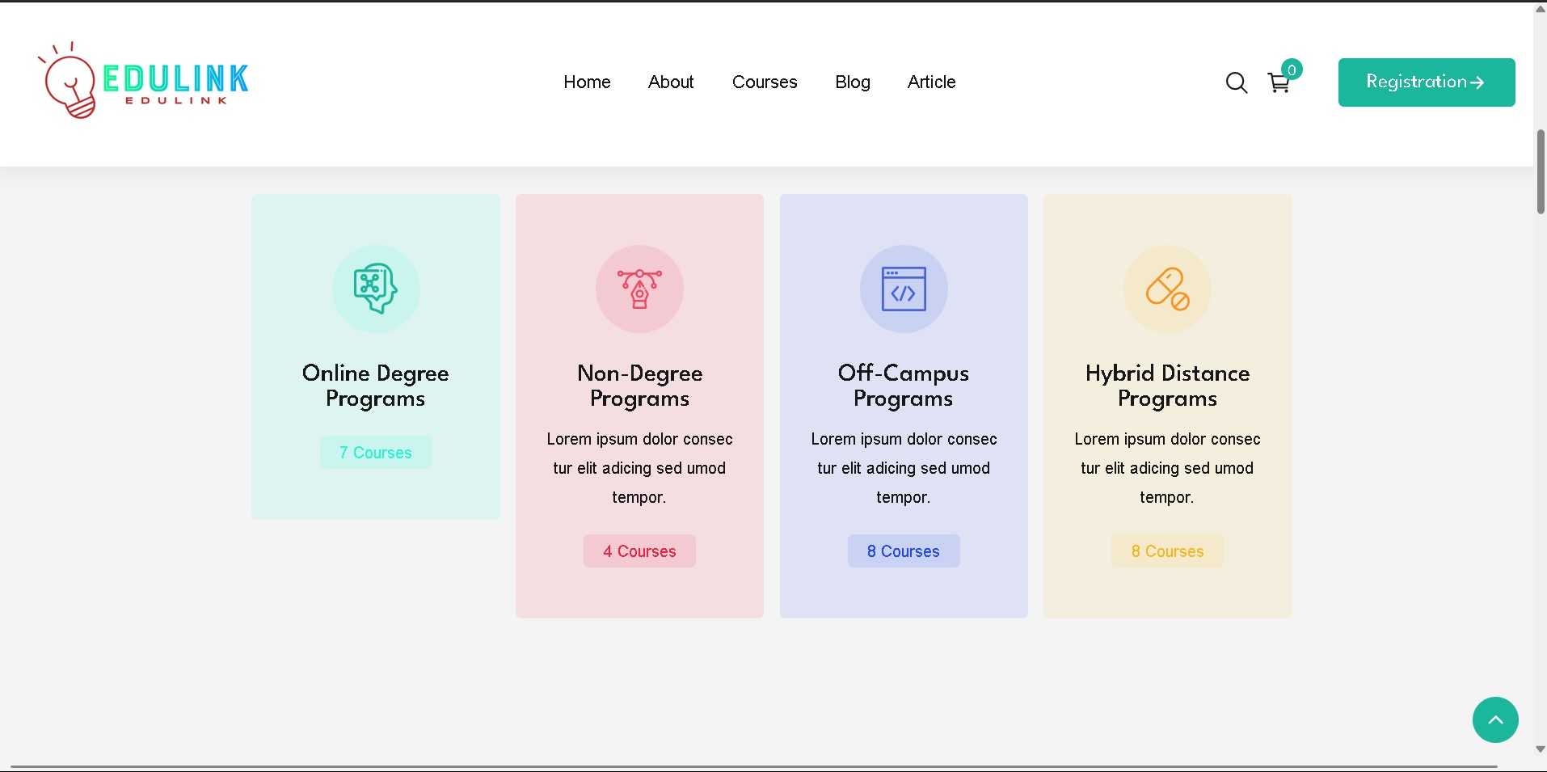
Basic Overview

Slide 7
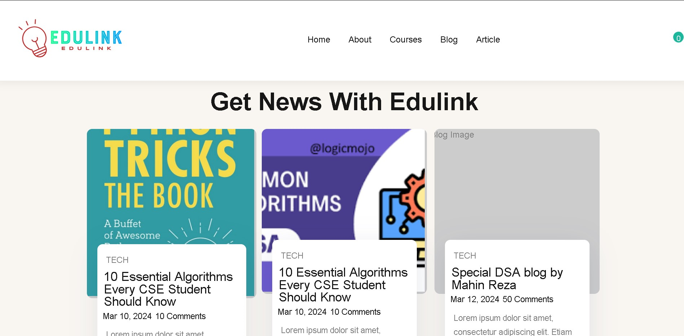
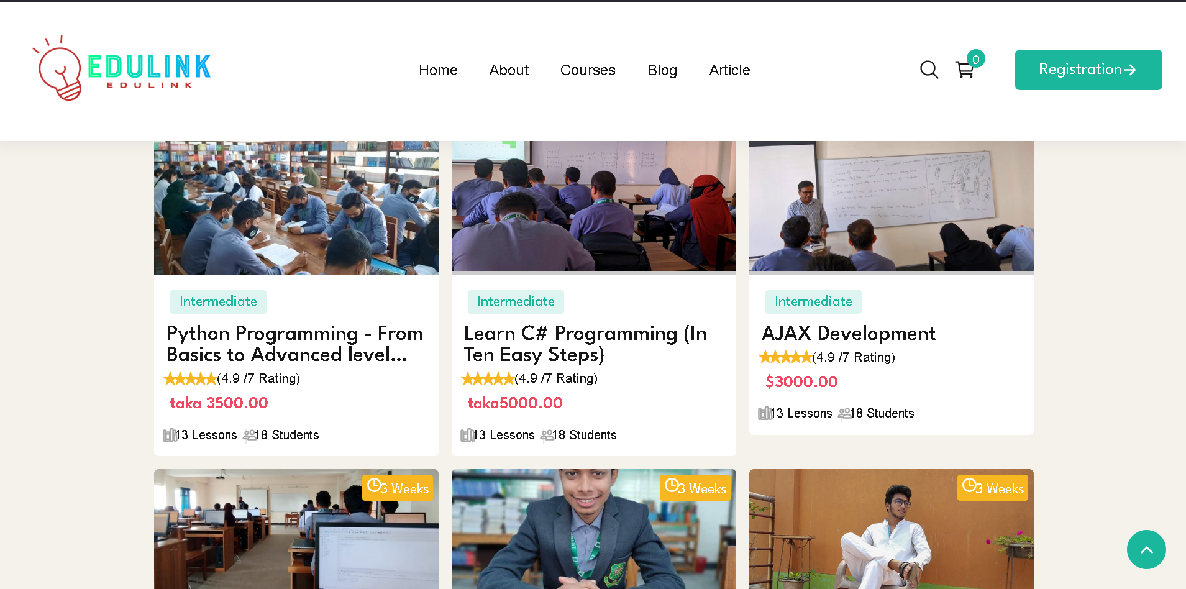
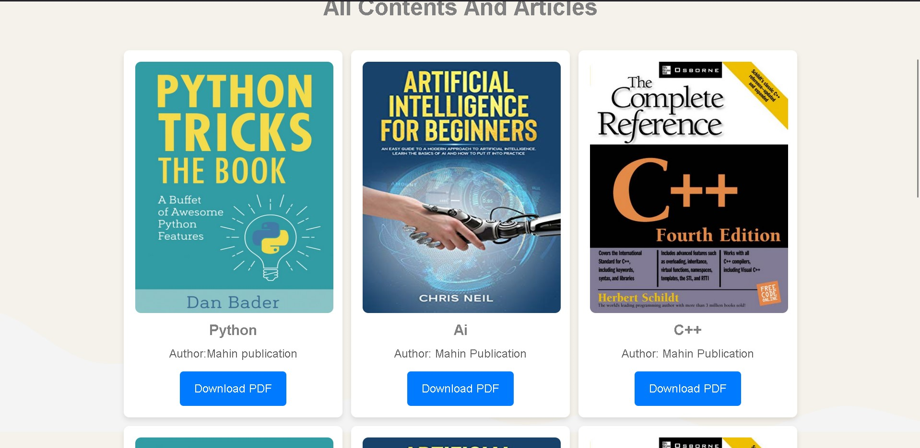
Basic Overview

Slide 8
Future Scope

Slide 9
Conclusion
Provide a brief summary of your presentation. Remind the audience what you covered in the previous slides.

Slide 10
Questions & answers
Invite questions from the audience

